Slide 1
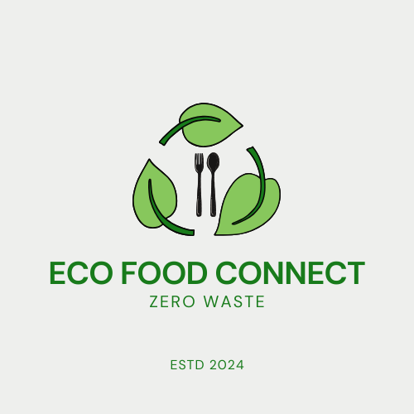
ECO FOOD CONNECT
Bhavya Likhitha Bukka
Tanmay Devraj Pillai
Akshay Raj Chevala

Slide 2
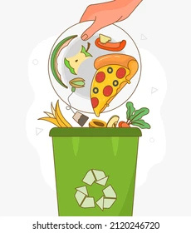
PROBLEM STATEMENT
The U.S. wastes 133 billion pounds of food yearly
Restaurants generate surplus food but lack efficient redistribution systems.
Poor coordination among stakeholders
A unified platform can streamline food redistribution and reduce waste.

Slide 3
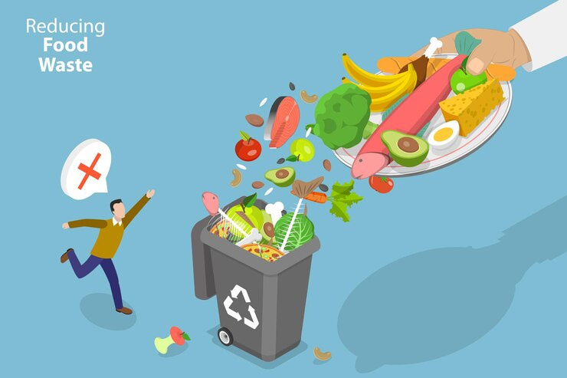
SOLUTION
EcoFood Connect bridges the gap between restaurants, food banks, logistics companies, and waste management firms.
Smoothening the process of food donation.
Managing the transportation of surplus food. Appropriate disposal of non-edible food waste

Slide 4
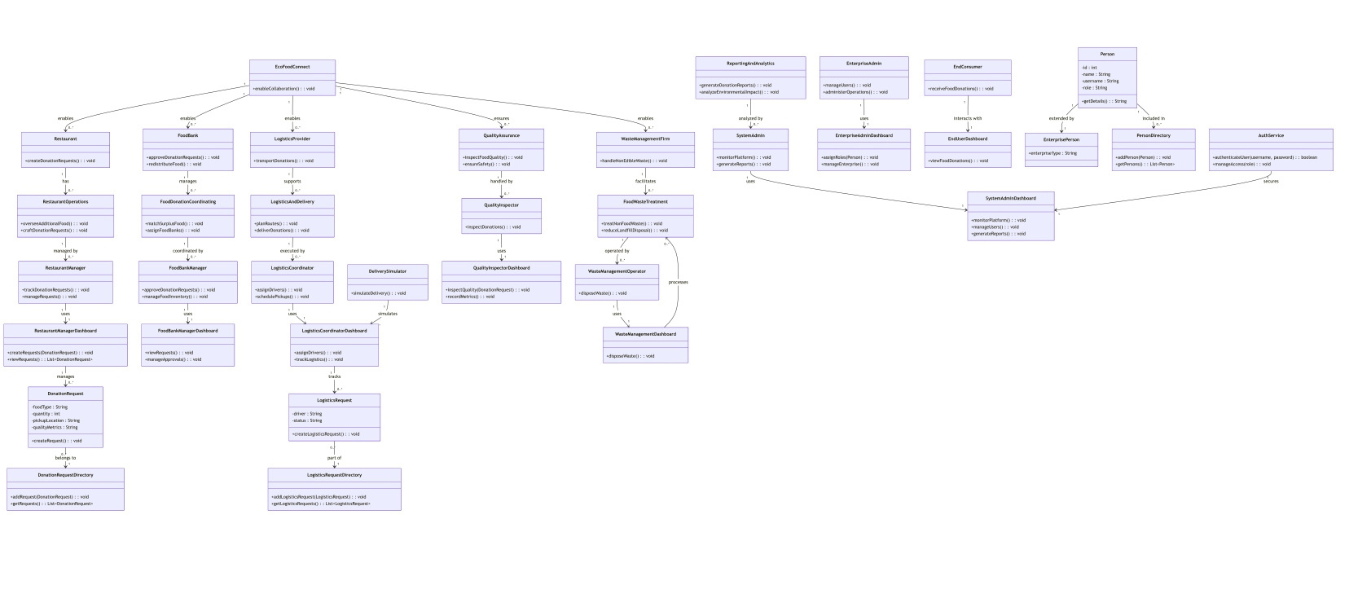
UML DIAGRAM

Slide 5
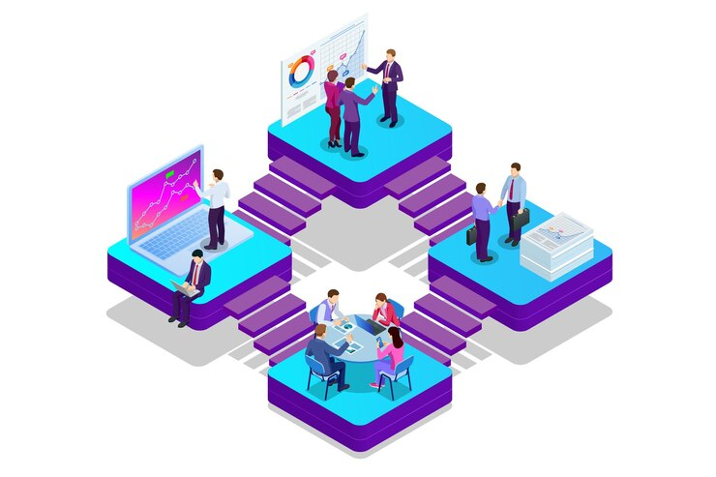
ADVANCED FEATURES
Centralized Coordination
Impact Metrics
Role-Based Functionality
Waste Management Integration

Slide 6
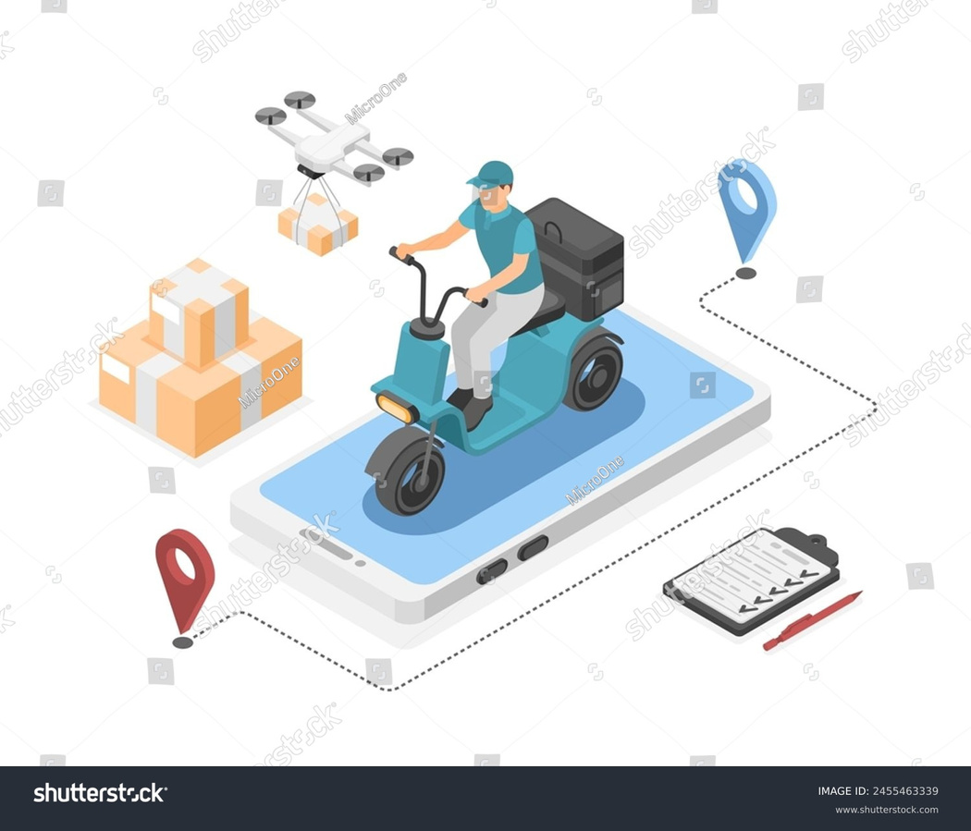
USE CASE HIGHLIGHT
Food Donation Request Workflow
Restaurant Manager creates a donation request
Food Bank Manager reviews and approves/rejects the request.
Quality Inspector evaluates the food
Logistics Coordinator assigns a driver and schedules pickup.
Food is delivered, and the request is marked as "Completed."

Slide 7

IMPACT AND VISION
Reduces food waste
Lowers greenhouse gas emissions and landfill waste.
Empowers collaboration
Improves operational efficiency for restaurants, food banks, and logistics providers.

Slide 8
Thank you

